Slide 1

Advanced Workshop 1: Convolutional Neural Nets (CNNs)
Vladislav Yotkov

Slide 2
Topics we will cover
Motivation for the convolutional neural network
Convolutional operation
Convolutional layer & properties
Activation layer
Pooling Layer
Training:
Backpropagation
Optimization
Three key concepts
Human vision analogue

Slide 3
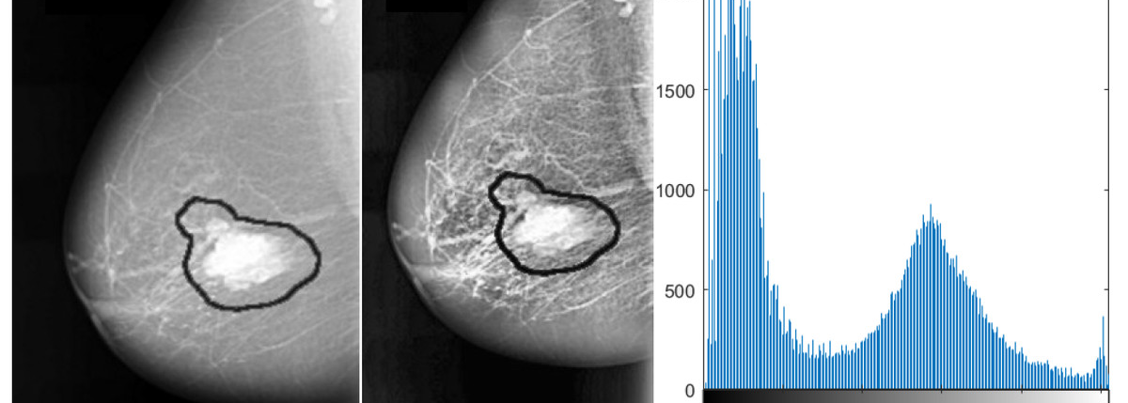
Practical Motivation for CNNs: Medical Imagery
Notes:
To begin with, CNNs are important to be studied due to their extensive use in feature detection in images. To appreciate this, note that CNNs support detection of medical issues like cancer and tumors.
As in this example, AlexNet is trained and utilized to recognize breast cancer with an accuracy of 87.2%. To achieve this remarkable score, the CNN is combined with an SVM, connected to the final dense layer for better classification.
On the right, you see a histogram representation of the image, with each bin corresponding to a grey scale value from white to black, widely used in Image Processing.

Slide 4
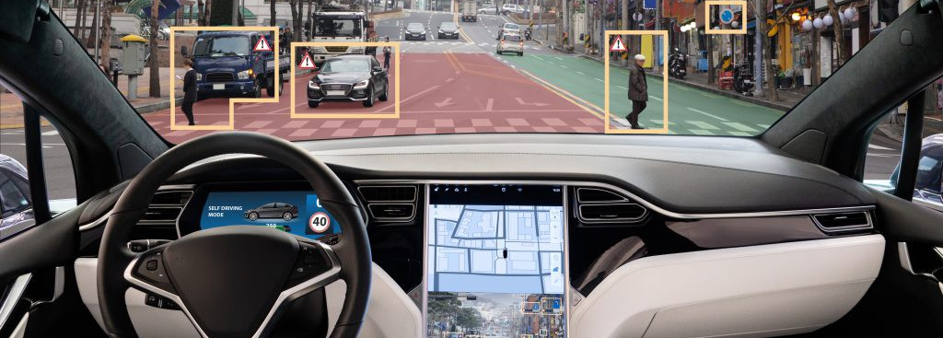
Practical Motivation for CNNs: Image Tagging & Computer Vision
https://medium.com/the-wisdom-1-0/self-driving-car-using-cnn-8c13c2b4c81e

Slide 5
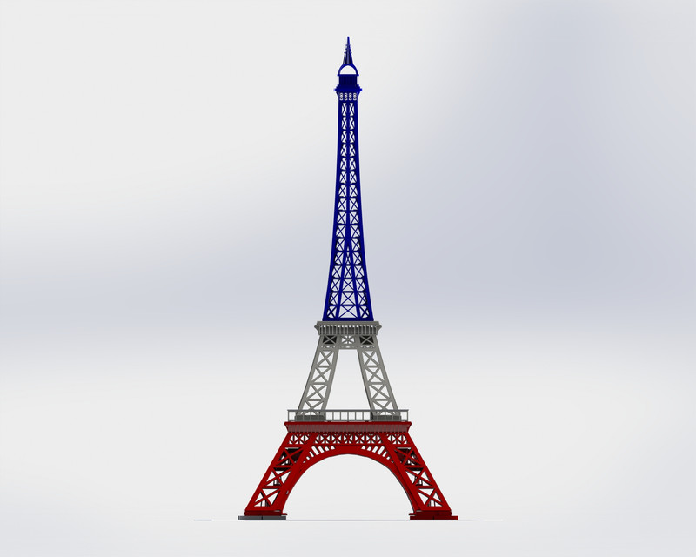
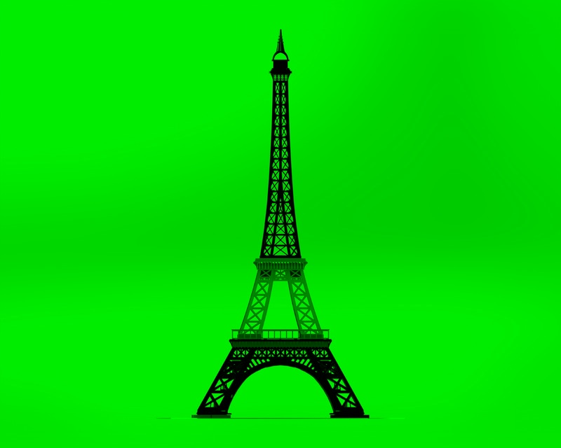
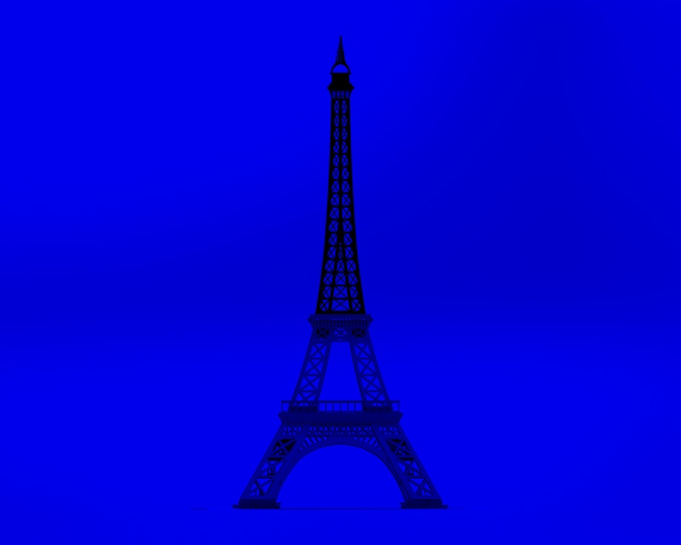
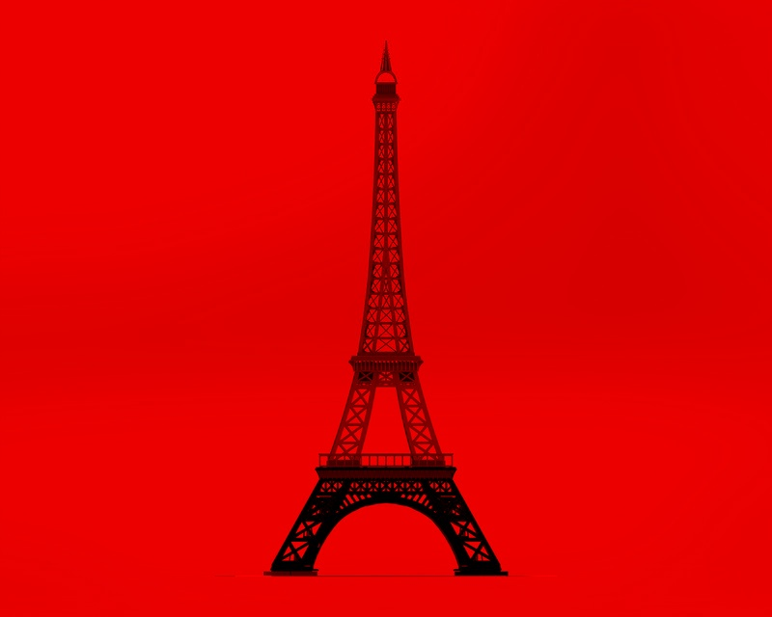
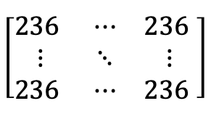
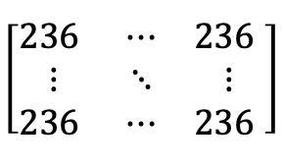
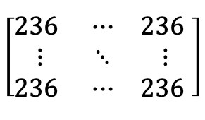
Computer Vision: Images
Original Image
RGB Channels
Matrix representation
$$\left[\begin{matrix}236 & ⋯ & \text{236} \\ ⋮ & ⋱ & ⋮ \\ \text{236} & ⋯ & \text{236} \end{matrix}\right]$$
$$\left[\begin{matrix}236 & ⋯ & \text{236} \\ ⋮ & ⋱ & ⋮ \\ \text{236} & ⋯ & \text{236} \end{matrix}\right]$$
$$\left[\begin{matrix}236 & ⋯ & \text{236} \\ ⋮ & ⋱ & ⋮ \\ \text{236} & ⋯ & \text{236} \end{matrix}\right]$$

Slide 6
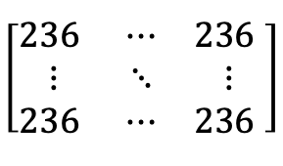
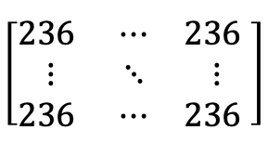
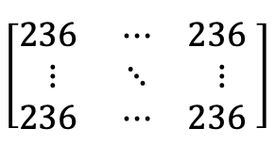
Fully-Connected Feed-Forward Neural network
x₁
h_{1,1}
.
.
.
.
.
.
.
.
.
h_{p,1}
. . . .
x₂
h_{1,2}
h_{p,2}
$$\left[\begin{matrix}236 & ⋯ & \text{236} \\ ⋮ & ⋱ & ⋮ \\ \text{236} & ⋯ & \text{236} \end{matrix}\right]$$
. . . .
P(Paris)=95%
$$\left[\begin{matrix}236 & ⋯ & \text{236} \\ ⋮ & ⋱ & ⋮ \\ \text{236} & ⋯ & \text{236} \end{matrix}\right]$$
.
.
.
.
.
.
.
.
.
ϕ
Flatten
P(New York) = 3%
$$\left[\begin{matrix}236 & ⋯ & \text{236} \\ ⋮ & ⋱ & ⋮ \\ \text{236} & ⋯ & \text{236} \end{matrix}\right]$$
x_{ND}
h_{1,K}
h_{P,L}
Activation Layer
P(London) = 2%
. . . .
Input Matrix
size: (3 x N x D)
Dense Hidden Layer 1
(K x 1)
Dense Hidden Layer P
(L x 1)
Output Layer
Input Layer
size: (ND x 1)
Notes:
Traditional Neural Networks are not efficient for image processing because:
We would need to learn a different-sized weight matrix W for every size of the input image. (for an image of size 9x9 with a convolutional layer with 7 neurons a fully connected feed-forward neural network would need 9x9x7x7=3969 connections, whereas a CNN with only one kernel -> 3x3).
The weight matrix would be massively memory inefficient;
They do not exhibit translation invariance;

Slide 7

Convolutional Neural network: Overview
https://towardsdatascience.com/a-comprehensive-guide-to-convolutional-neural-networks-the-eli5-way-3bd2b1164a53
Notes:
CNNs operate are trained on labelled data and so are supervised.
In GAN lecture there will be another notion for the CNNs to be used in an unsupervised learning manner.

Slide 8
What is Convolution?
0 | 0 | 1 | 0 | 0
0 | 1 | 2 | 1 | 0
1 | 2 | 2 | 2 | 1
0 | 1 | 2 | 1 | 0
0 | 0 | 1 | 0 | 0
Convolution is the technique that allows us to perform feature detection.
Types:
Cross-correlation
Discrete
Properties:
Padding
Stride
0 | 1 | 0
0 | 1 | 0
0 | 1 | 0
Kernel Filter
(3x3)
Input Image Matrix
(5x5)

Slide 9
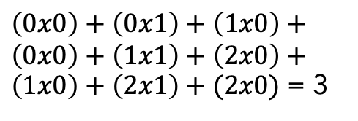
Convolution: Visualization 1
Receptive field
0 | 0 | 1 | 0 | 0
0 | 1 | 2 | 1 | 0
1 | 2 | 2 | 2 | 1
0 | 1 | 2 | 1 | 0
0 | 0 | 1 | 0 | 0
0 | 1 | 0
0 | 1 | 0
0 | 1 | 0
3
=
*
Kernel Filter
(3x3)
Feature Map
(3x3)
Input Image Matrix
(5x5)
$\left(0x0\right)+\left(0x1\right)+\left(1x0\right)+\left(0x0\right)+\left(1x1\right)+\left(2x0\right)+\left(1x0\right)+\left(2x1\right)+(2x0)$ = 3

Slide 10
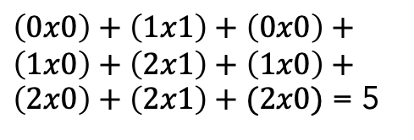
Cross-correlation: Visualization 2
0 | 0 | 1 | 0 | 0
0 | 1 | 2 | 1 | 0
1 | 2 | 2 | 2 | 1
0 | 1 | 2 | 1 | 0
0 | 0 | 1 | 0 | 0
0 | 1 | 0
0 | 1 | 0
0 | 1 | 0
3 | 5
=
*
Kernel Filter
(3x3)
Feature Map
(3x3)
Input Image Matrix
(5x5)
$\left(0x0\right)+\left(1x1\right)+\left(0x0\right)+\left(1x0\right)+\left(2x1\right)+\left(1x0\right)+\left(2x0\right)+\left(2x1\right)+(2x0)$ = 5

Slide 11
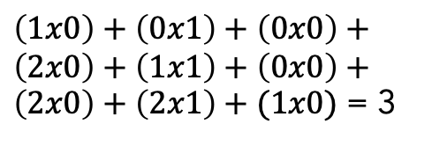
Cross-correlation: Visualization 3
0 | 0 | 1 | 0 | 0
0 | 1 | 2 | 1 | 0
1 | 2 | 2 | 2 | 1
0 | 1 | 2 | 1 | 0
0 | 0 | 1 | 0 | 0
0 | 1 | 0
0 | 1 | 0
0 | 1 | 0
3 | 5 | 3
=
*
Kernel Filter
(3x3)
Feature Map
(3x3)
Input Image Matrix
(5x5)
$\left(1x0\right)+\left(0x1\right)+\left(0x0\right)+\left(2x0\right)+\left(1x1\right)+\left(0x0\right)+\left(2x0\right)+\left(2x1\right)+(1x0)$ = 3

Slide 12
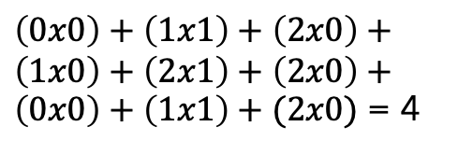
Cross-correlation: Visualization 4
0 | 0 | 1 | 0 | 0
0 | 1 | 2 | 1 | 0
1 | 2 | 2 | 2 | 1
0 | 1 | 2 | 1 | 0
0 | 0 | 1 | 0 | 0
0 | 1 | 0
0 | 1 | 0
0 | 1 | 0
3 | 5 | 3
4
=
*
Kernel Filter
(3x3)
Feature Map
(3x3)
Input Image Matrix
(5x5)
$\left(0x0\right)+\left(1x1\right)+\left(2x0\right)+\left(1x0\right)+\left(2x1\right)+\left(2x0\right)+\left(0x0\right)+\left(1x1\right)+(2x0)$ = 4

Slide 13
Cross-correlation: Visualization 5
0 | 0 | 1 | 0 | 0
0 | 1 | 2 | 1 | 0
1 | 2 | 2 | 2 | 1
0 | 1 | 2 | 1 | 0
0 | 0 | 1 | 0 | 0
0 | 1 | 0
0 | 1 | 0
0 | 1 | 0
3 | 5 | 3
4 | 6
=
*
Kernel Filter
(3x3)
Feature Map
(3x3)
Input Image Matrix
(5x5)

Slide 14
Cross-correlation: Visualization 6
0 | 0 | 1 | 0 | 0
0 | 1 | 2 | 1 | 0
1 | 2 | 2 | 2 | 1
0 | 1 | 2 | 1 | 0
0 | 0 | 1 | 0 | 0
0 | 1 | 0
0 | 1 | 0
0 | 1 | 0
3 | 5 | 3
4 | 6 | 4
=
*
Kernel Filter
(3x3)
Feature Map
(3x3)
Input Image Matrix
(5x5)

Slide 15
Cross-correlation: Visualization 7
0 | 0 | 1 | 0 | 0
0 | 1 | 2 | 1 | 0
1 | 2 | 2 | 2 | 1
0 | 1 | 2 | 1 | 0
0 | 0 | 1 | 0 | 0
0 | 1 | 0
0 | 1 | 0
0 | 1 | 0
3 | 5 | 3
4 | 6 | 4
3
=
*
Kernel Filter
(3x3)
Feature Map
(3x3)
Input Image Matrix
(5x5)

Slide 16
Cross-correlation: Visualization 8
0 | 0 | 1 | 0 | 0
0 | 1 | 2 | 1 | 0
1 | 2 | 2 | 2 | 1
0 | 1 | 2 | 1 | 0
0 | 0 | 1 | 0 | 0
0 | 1 | 0
0 | 1 | 0
0 | 1 | 0
3 | 5 | 3
4 | 6 | 4
3 | 5
=
*
Kernel Filter
(3x3)
Feature Map
(3x3)
Input Image Matrix
(5x5)

Slide 17
Cross-correlation: Visualization 9
0 | 0 | 1 | 0 | 0
0 | 1 | 2 | 1 | 0
1 | 2 | 2 | 2 | 1
0 | 1 | 2 | 1 | 0
0 | 0 | 1 | 0 | 0
0 | 1 | 0
0 | 1 | 0
0 | 1 | 0
3 | 5 | 3
4 | 6 | 4
3 | 5 | 3
=
*
Kernel Filter
(3x3)
Feature Map
(3x3)
Input Image Matrix
(5x5)
* Valid 1-strided convolution

Slide 18
Properties of Convolution: Padding
Same Convolution
Output has the same size as input.
0 | 0 | 0 | 0 | 0 | 0 | 0
0 | 0 | 0 | 1 | 0 | 0 | 0
0 | 0 | 1 | 2 | 1 | 0 | 0
0 | 1 | 2 | 2 | 2 | 1 | 0
0 | 0 | 1 | 2 | 1 | 0 | 0
0 | 0 | 0 | 1 | 0 | 0 | 0
0 | 0 | 0 | 0 | 0 | 0 | 0
0 | 1 | 3 | 1 | 0
1 | 3 | 5 | 3 | 1
1 | 4 | 6 | 4 | 1
1 | 3 | 5 | 3 | 1
0 | 1 | 3 | 1 | 0
0 | 1 | 0
0 | 1 | 0
0 | 1 | 0
=
*
Kernel Filter
(3x3)
Feature Map
(5x5)
Input Image Matrix
(5x5)
+ zero-padding = (7x7)

Slide 19
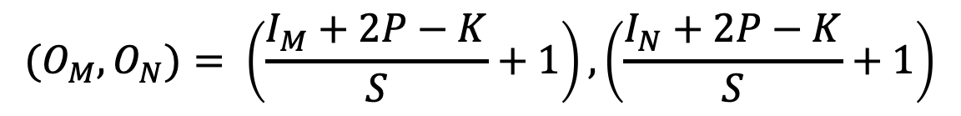
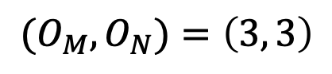
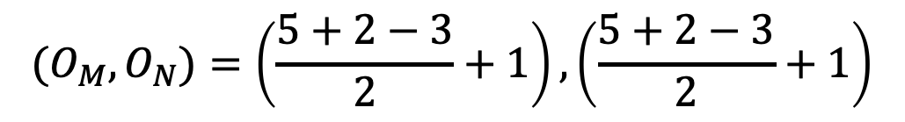
Properties of Convolution: Stride
Formula for Output size
$${(O}_{M},O_{N})= \left(\frac{I_{M}+2P−K}{S}+1\right),\left(\frac{I_{N}+2P−K}{S}+1\right)$$
0 | 0 | 0 | 0 | 0 | 0 | 0
0 | 0 | 0 | 1 | 0 | 0 | 0
0 | 0 | 1 | 2 | 1 | 0 | 0
0 | 1 | 2 | 2 | 2 | 1 | 0
0 | 0 | 1 | 2 | 1 | 0 | 0
0 | 0 | 0 | 1 | 0 | 0 | 0
0 | 0 | 0 | 0 | 0 | 0 | 0
$${(O}_{M},O_{N})=\left(\frac{5+2−3}{2}+1\right),\left(\frac{5+2−3}{2}+1\right)$$
$${(O}_{M},O_{N})=\left(3, 3\right)$$
Notes:
A bigger stride would result in smaller overlap of receptive fields.

Slide 20
Convolutional Neural network
https://towardsdatascience.com/a-comprehensive-guide-to-convolutional-neural-networks-the-eli5-way-3bd2b1164a53
Notes:
This is Lenet-1 with error rate on MNIST 1.7%.

Slide 21
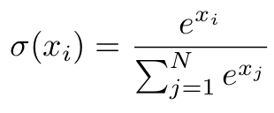
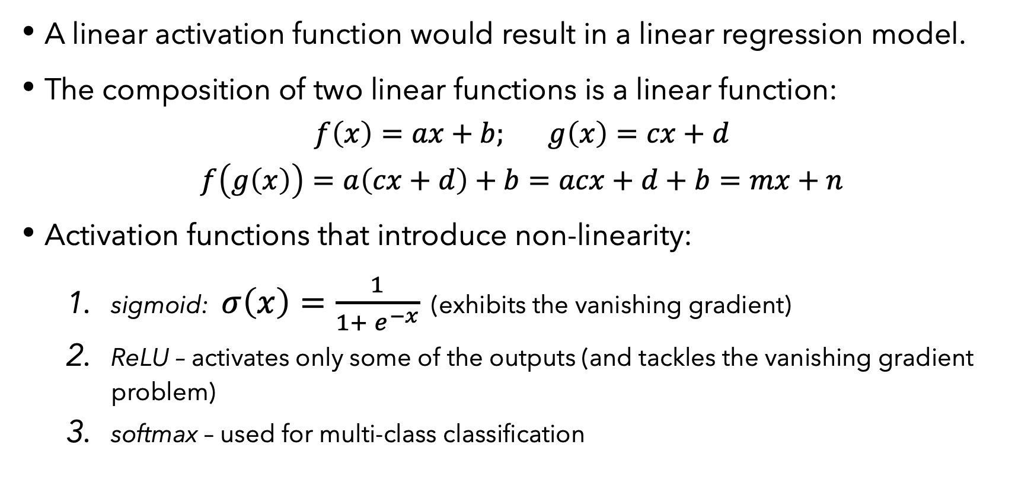
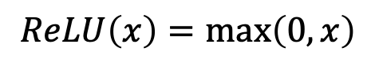
Activation Layer: Problem of linearity
A linear activation function would result in a linear regression model.
The composition of two linear functions is a linear function: $f\left(x\right)=ax+b; g\left(x\right)=cx+d$
$$f\left(g\left(x\right)\right)=a\left(cx+d\right)+b=acx+d+b=mx+n$$
Activation functions that introduce non-linearity:
sigmoid: $σ\left(x\right)=\frac{1}{1+ e^{−x}}$ (exhibits the vanishing gradient)
ReLU – activates only some of the outputs (and tackles the vanishing gradient problem)
softmax – used for multi-class classification
$$ReLU\left(x\right)=\max\left(0, x\right)$$
Notes:
In order to find non-linear patterns in data we should use non-linear activation functions that would allow the network to learn.
Negative weights affect the ReLU training process and effectively cause the Dead ReLU.
Solutions:
1) Non-saturating ReLU
(Leaky ReLU)
LReLU(a; alpha) = max(alpha*a, a)
2) Parametric ReLU to allow the parameter alpha to be learned

Slide 22
Pooling Layer: Down-Sampling
Max pooling,
2x2 filter,
stride of 1
0 | 2 | 2 | 0
2 | 2 | 2 | 2
2 | 2 | 2 | 2
0 | 2 | 2 | 0
0 | 0 | 0 | 0 | 0
0 | 0 | 2 | 0 | 0
0 | 2 | 2 | 2 | 0
0 | 0 | 2 | 0 | 0
0 | 0 | 0 | 0 | 0
Average pooling,
2x2 filter,
stride of 1
0 | 0.5 | 0.5 | 0
0.5 | 1.5 | 1.5 | 0.5
0.5 | 1.5 | 1.5 | 0.5
0 | 0.5 | 0.5 | 0
Notes:
What?
The pooling layer helps make the representation become approximately invariant to small translations of the input image.
Why?
A limitation of the feature map output of convolutional layers is that they record the precise position of features in the input. Thus, a small movement like re-cropping, rotation or shifting will lead to a different feature map
Solution?
Down-sampling is forming a lower resolution version that still contains the large or important elements, without the fine detail.

Slide 23
Convolutional Output Feature Maps
Siddiqui, Shoaib & Salman, Ahmad & Malik, Imran & Shafait, Faisal & Mian, Ajmal & Shortis, Mark & Harvey, Euan. (2017). ICES Journal of Marine Science.
Notes:
Essentially, the convolutional layer is the key building block of the CNN.
Kernel filters capture the structure of the input image (receptive fields) and produce feature maps.
First convolutional layers recognize simple features like straight lines, corners or curves.
And the deeper our image moves forward into the neural network the more detailed would the feature extraction would be.

Slide 24
Convolutional Neural network
https://towardsdatascience.com/a-comprehensive-guide-to-convolutional-neural-networks-the-eli5-way-3bd2b1164a53
Notes:
This is Lenet-1 with error rate on MNIST 1.7%.

Slide 25
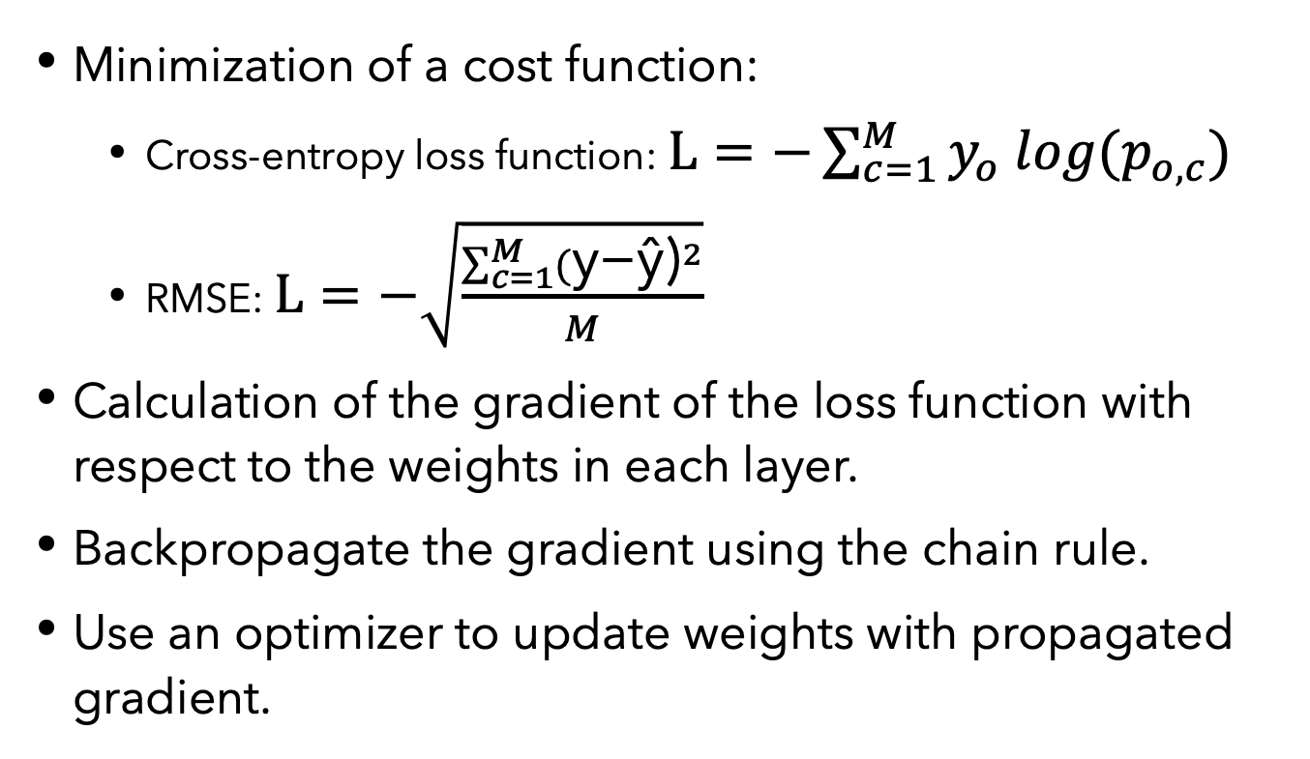
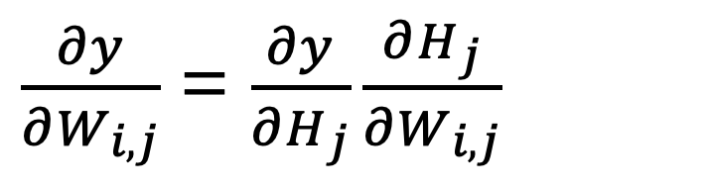
How to train a CNN?
Minimization of a cost function:
Cross-entropy loss function: $L=−\sum_{c=1}^{M}{y_{o} log{(p}_{o,c})}$
RMSE: $L=−\sqrt{\frac{\sum_{c=1}^{M}{{(\text{y}\text{−}\text{ŷ}\text{)}}^{2}}}{M}}$
Calculation of the gradient of the loss function with respect to the weights in each layer.
Backpropagate the gradient using the chain rule.
Use an optimizer to update weights with propagated gradient.
$\frac{∂y}{∂W_{i,j}}$ = $\frac{∂y}{∂H_{j}}\frac{∂H_{j}}{∂W_{i,j}}$
Notes:
Layers depend on the previous ones.

Slide 26
Backpropagation On weights
x
h₁
ϕ
h₂
ϕ
ŷ
C(ŷ, y)
b₁
b₂
Non-graphical representation:
Useful derivatives for backprop

Slide 27
Backpropagation On weights
x
h₁
ϕ
h₂
ϕ
ŷ
C(ŷ, y)
b₁
b₂
STEP 1
Non-graphical representation:
Useful derivatives for backprop

Slide 28
Backpropagation On weights
x
h₁
ϕ
h₂
ϕ
ŷ
C(ŷ, y)
b₁
b₂
STEP 2
Non-graphical representation:
Useful derivatives for backprop

Slide 29
Backpropagation On weights
x
h₁
ϕ
h₂
ϕ
ŷ
C(ŷ, y)
b₁
b₂
STEP 3
Non-graphical representation:
STEP 2
Useful derivatives for backprop

Slide 30
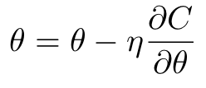
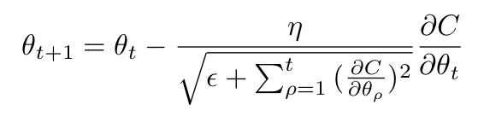
Optimization
Calculate gradient wrt. weights, biases, activations.
Store weights & biases gradients in a gradient vector:
Use an optimizer:
Stochastic Gradient Descent
AdaGrad (Adaptive Gradient)
RMSProp
Adam
Notes:
AdaGrad changes the learning rate over time as more gradients are being calculated and added to the summation which decreases the learning rate over time. Thus, initially we would take big leaps in finding the global minima, and slow down as we get closer.
Root mean squared prop

Slide 31
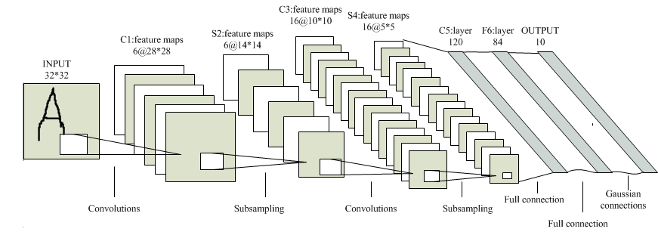
Convolutional Neural network: Lenet-5
This Photo by Unknown Author is licensed under CC BY-SA-NC
Notes:
Lenet-5 has an error rate of 0.95%.
The newer model adds in more feature maps, a fully-connected layer to the output, uses average pooling. /Currently it the max pooling is more preferable due to the filtering the strongest value of the receptive field, which results in a higher gradient during backprop./

Slide 32
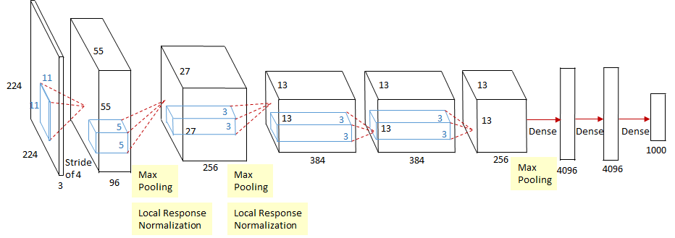
Convolutional Neural network: CaffeNet
https://medium.com/coinmonks/paper-review-of-alexnet-caffenet-winner-in-ilsvrc-2012-image-classification-b93598314160
Notes:
CaffeNet is the single GPU version of AlexNet
Before Alexnet, Tanh was used. ReLU is introduced in AlexNet. And ReLU is six times faster than Tanh to reach 25% training error rate.

Slide 33
Convolutional Neural network: three Key concepts
equivariance to translation
sparse Connectivity
parameter sharing

Slide 34
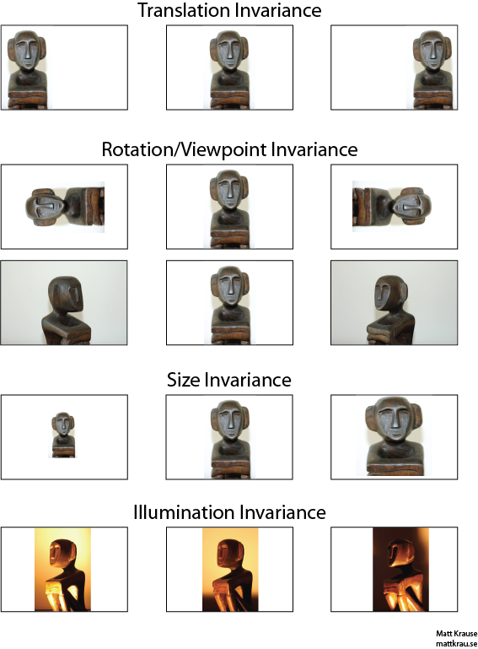
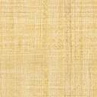
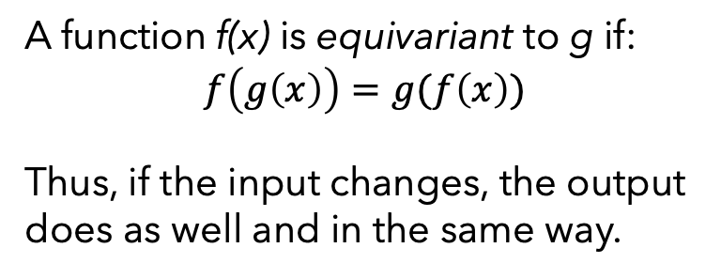
Key concept I: Equivariance to translation
NOT Applicable to transformations like:
rotation
change of scale
change of illumination
change of viewpoint
The above are dealt with the Pooling Layer.
A function f(x) is equivariant to g if:
$$f\left(g\left(x\right)\right)=g(f\left(x\right))$$
Thus, if the input changes, the output does as well and in the same way.
N.B.
Convolution is equivariant to translations.
https://stats.stackexchange.com/questions/208936/what-is-translation-invariance-in-computer-vision-and-convolutional-neural-netwoa
Notes:
Equivariance applies to simple transformations like translation.
For approximated invariance we utilize the pooling layer.

Slide 35
Key concept II: Sparse Connectivity
Sparsely Connected Layers
Densely Connected Layers
Sparse connectivity is achieved with small kernels that capture detail. Thus:
Less parameters to optimize;
Less memory to use;
Less computation to perform;
Improved statistical efficiency;
*Graphs from Deep Learning, Ian Goodfellow

Slide 36
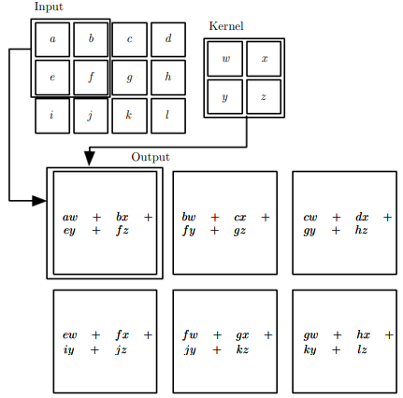
Key concept III: Parameter sharing
Traditional Neural Networks use a single weight only once.
Whereas CNNs re-use the kernel’s weights for each receptive field:
Optimized memory and computation.
Statistical accuracy due to translation invariance.
https://cedar.buffalo.edu/~srihari/CSE676/7.9%20ParameterSharing.pdf

Slide 37
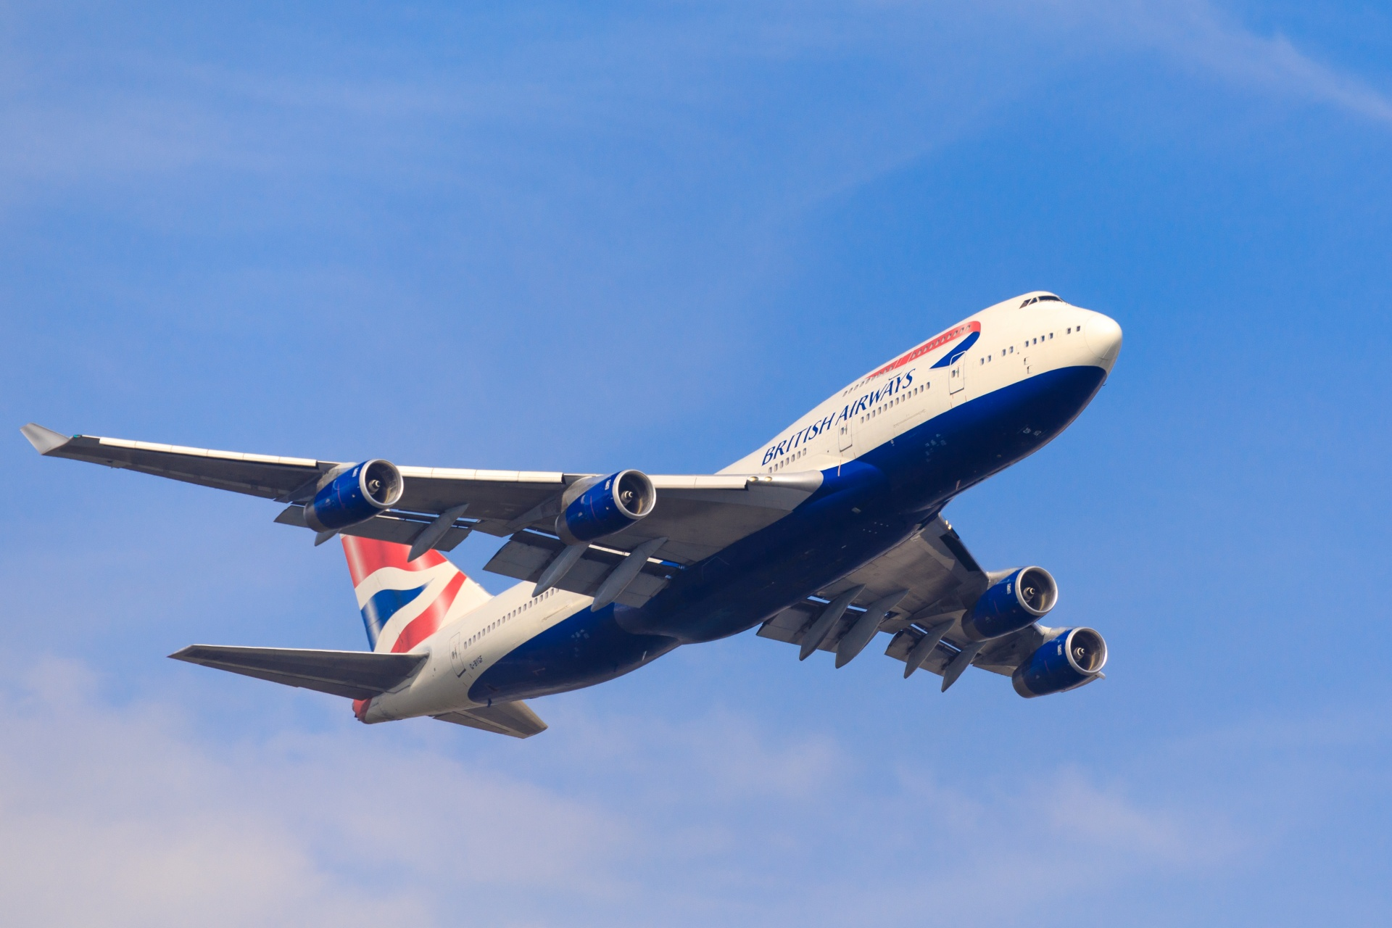
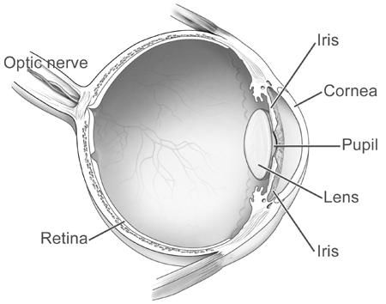
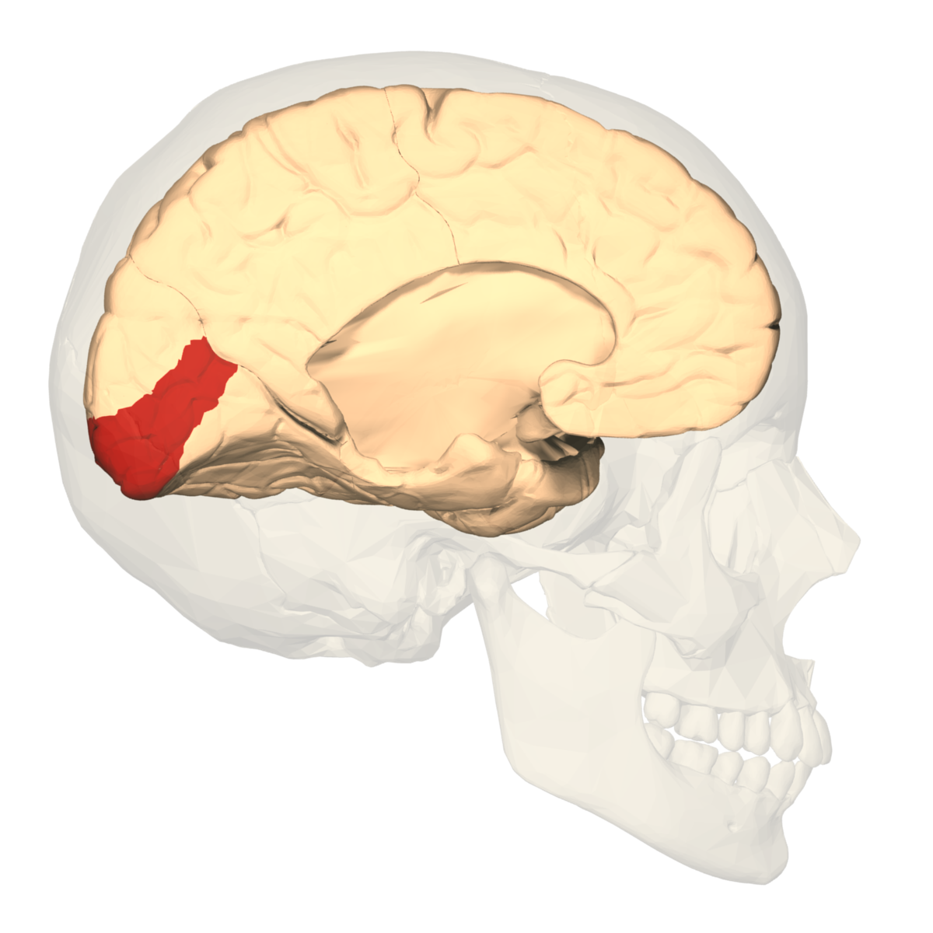
Human vision
Light stimulates the retina, the light-sensitive tissue.
The optic nerve and the LGN carry the signal through to the Primary Visual Cortex (V1)
Notes:
Images are formed by light arriving in the eye and stimulating the retina, the light-sensitive tissue in the back of the eye.
The image then passes through an optic nerve and the lateral geniculate nucleus(LGN) -> both carry the signal from the eye to the primary visual cortex (V1) at the back of the head.

Slide 38
Primary visual cortex & CNN
V1 has a two-dimensional structure that mirrors the image of the retina.
The features in CNN are defined as two-dimensional maps.
V1 has simple cells that could be seen as a linear function of a small receptive field.
The CNN has feature detectors/filters.
V1 has complex cells that:
respond to similar features detected by simple cells;
are invariant to small shifts in the position of the feature;
The CNN has layers of pooling units which allow for the equivariance.

